Slide 1
Crime in Chicago
Bryan Benjamin, Meng-Yin Lee, Ivan Choi, Nicole Huffman

Slide 2
Introduction
Project Description
Our group conducted an analysis on Chicago crime rate vs property value analysis for year 2018, 2019 and 2020 April month to answer the questions we have defined for our project scope.
Questions we wanted to answer based on our prepared data set
Does crime rate go up when property value is in the lower range?
Does the time of day have an effect when property crime take place?
Does COVID19 ‘Stay-At-Home’ order in April 2020 influence crime rate?
In what zip code, there is the most crimes reported?

Slide 3
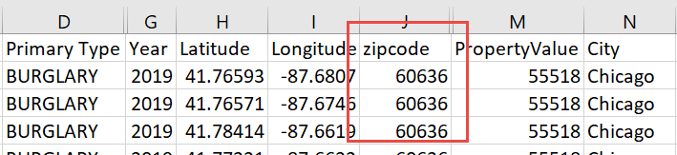
Data Preparation
Chicago Property Data
https://www.zillow.com/research/data/
Chicago Crime Data
https://data.cityofchicago.org/Public-Safety/Crimes-2001-to-Present/ijzp-q8t2
Chicago Income Data
https://data.census.gov/cedsci/profile?g=0500000US17031
Data cleaning and preparation methods:
Reverse Geocoding API call: Using (Latitue, Longitude) to get ‘zipcode’
DataFrame.Merge (on ‘zipcode’) : Merge data sets from Crime data, Property data, Income data
DataFrame.dropna(how=‘any’) : Remove ‘NaN’
DataFrame.dropduplicates
Binning/cut – Property range

Slide 4
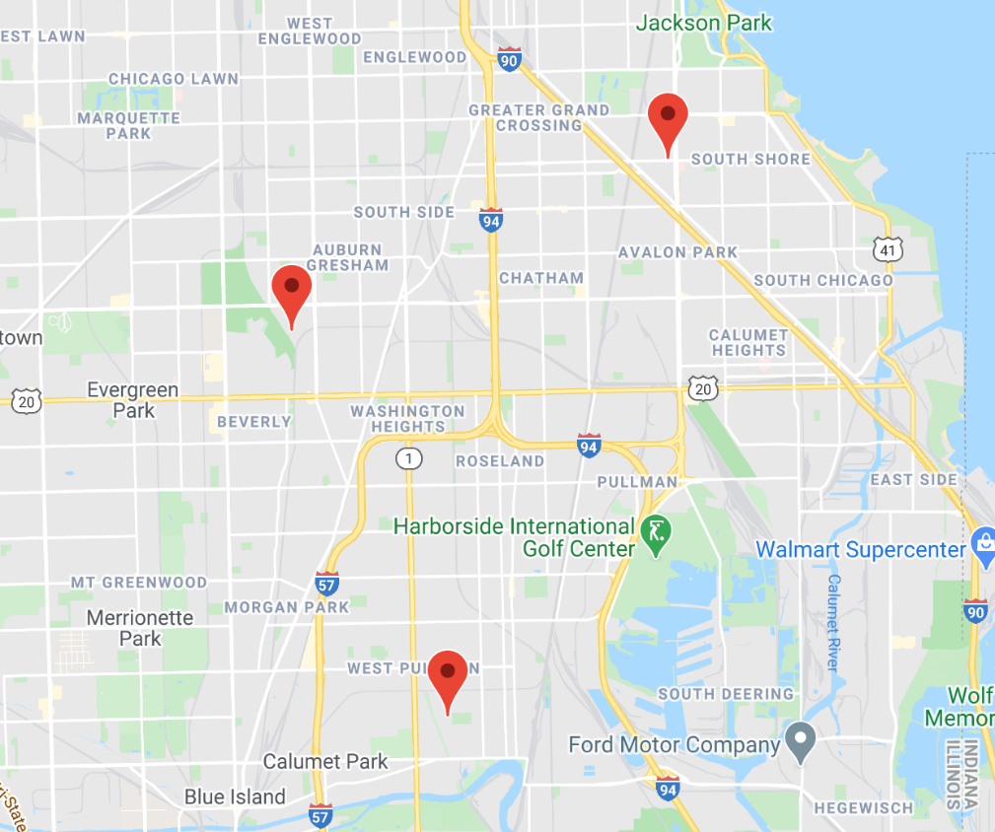
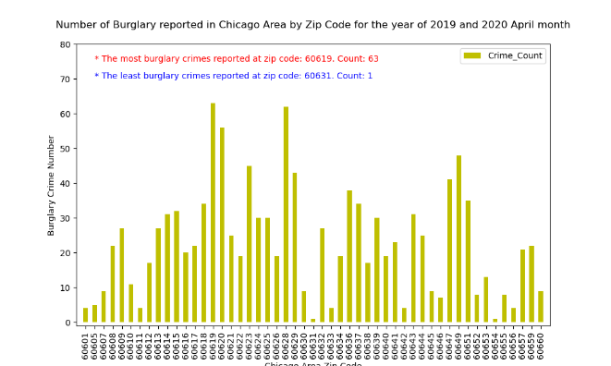
Top 3 Highest Areas of Crime

Slide 5
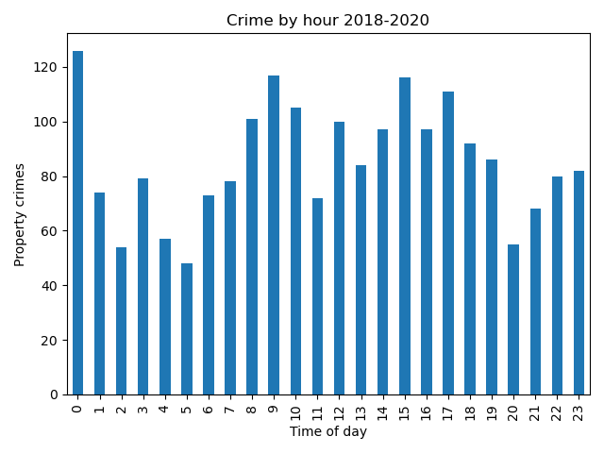
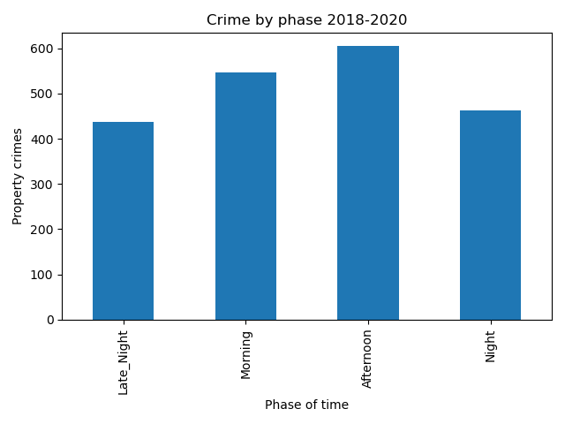
Crime By Time of Day
Midnight is the time when property crimes are reported the most.
Even though midnight has the highest number of reported crimes. The vast majority of property crimes happen in the afternoon between noon and 5pm.

Slide 6
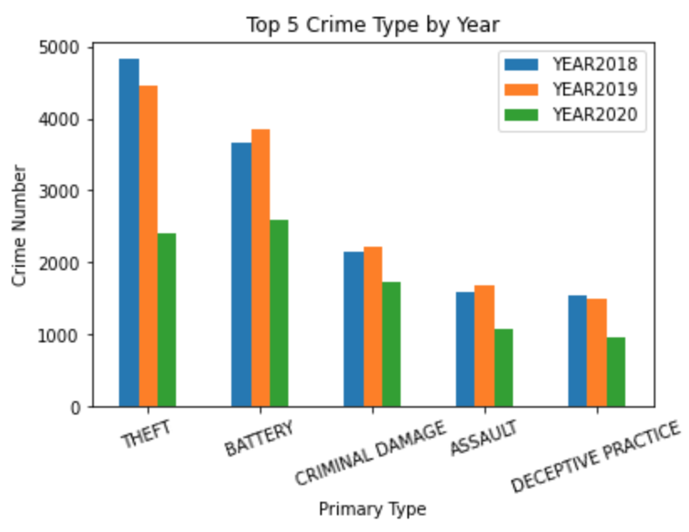
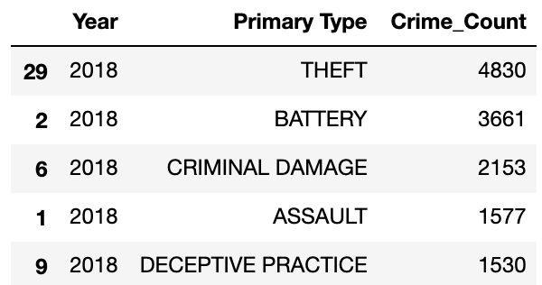
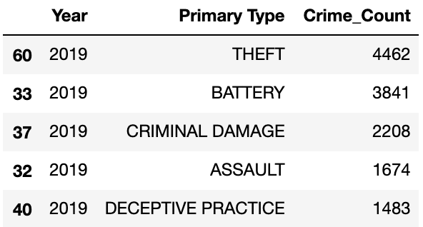
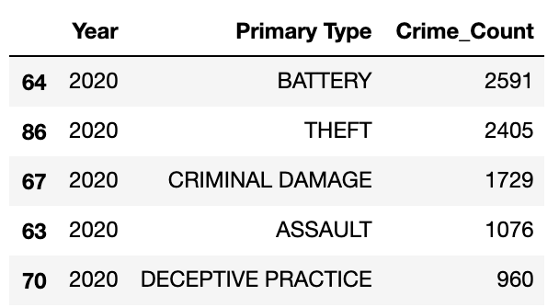
Does the crime rate drop in 2020 due to COVID19?

Slide 7
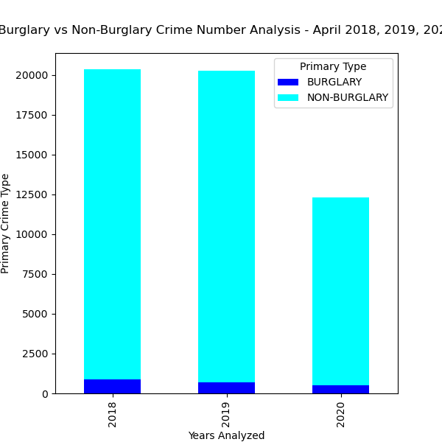
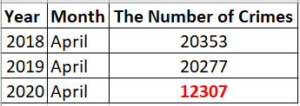
Does the crime rate drop in 2020 due to COVID19?
Comparing to year 2018, 2019 April
Year 2020 April has ~60% of crime numbers
We can conclude due to COVID19 ‘Stay-At-Home’ order
The crime rate has decreased.

Slide 8
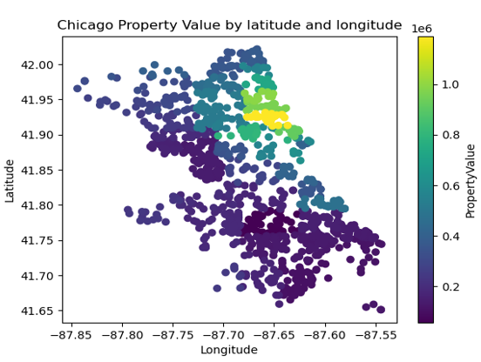
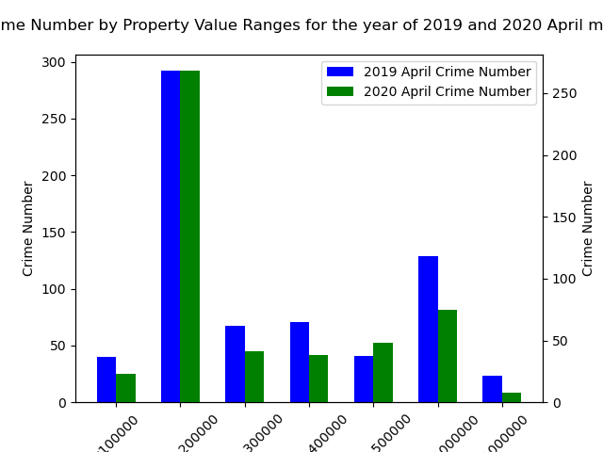
Property crime vs Property value
Most burglary crimes reported within the property value range
between 100000 and 200000, which is the most property locations. It indicates the relationship between crime rate and property value may not directly related. The crime rate is higher may just because there is more propertied and population

Slide 9
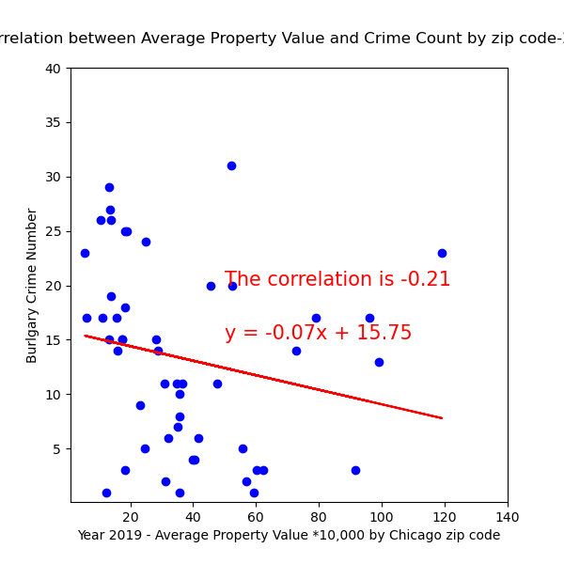
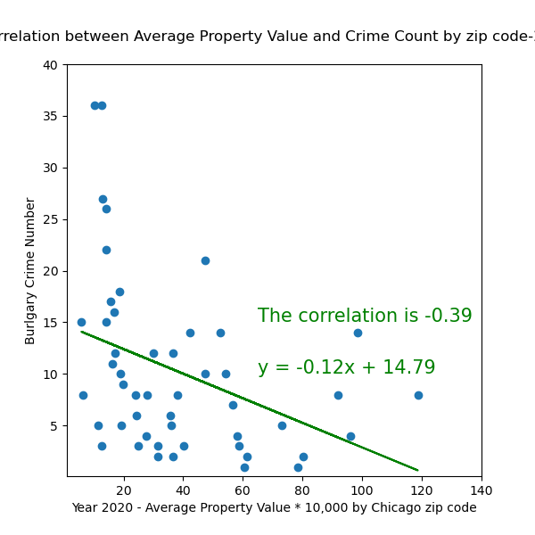
Is there strong correlation between crime number and property value?

Slide 10
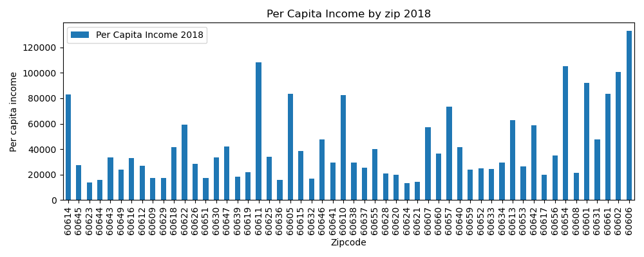
Per Capita Income By Zip Code

Slide 11
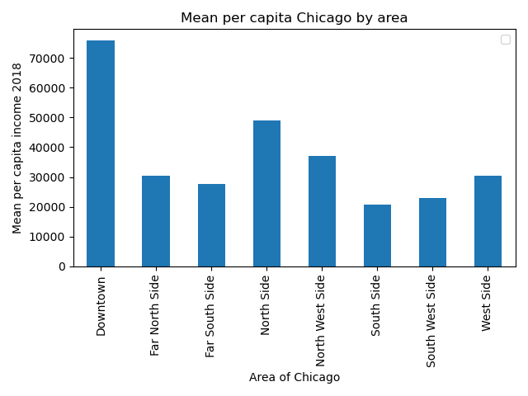
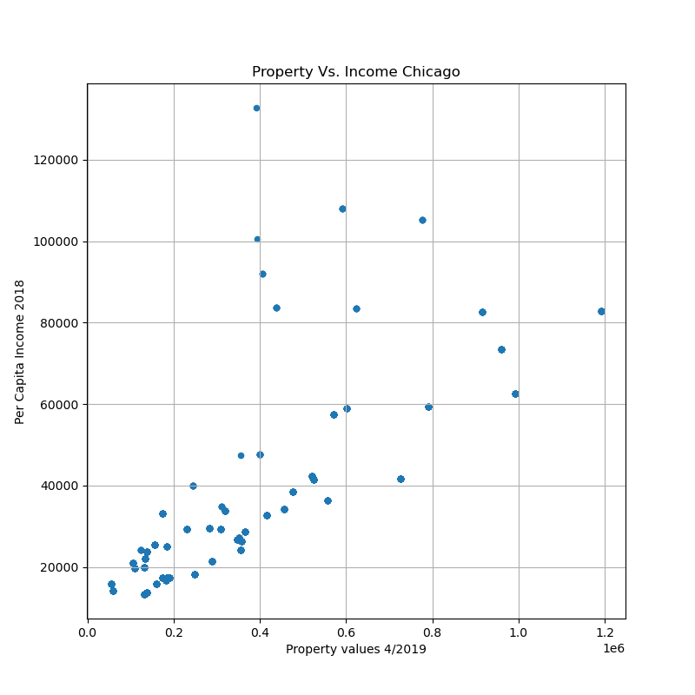
Per Capita By Area

Slide 12
In Conclusion
Does crime rate go up when property value is in the lower range?
No strong correlation.
Does the time of day have an effect when property crime take place?
Yes, property crime takes place between noon-5pm.
Does COVID19 ‘Stay-At-Home’ order in April 2020 influence crime rate?
Yes, we observed from our bar charts that there is a significant drop-in crime rate in April 2020 compared to previous years.

Slide 13
Postmortem
Issues encountered
Amount of data
Originally wanted to look at crime rates from 2000-2020
Missing data (zip codes)
There were a few zip codes that we could not find data on

Slide 14
Questions?!

Slide 15
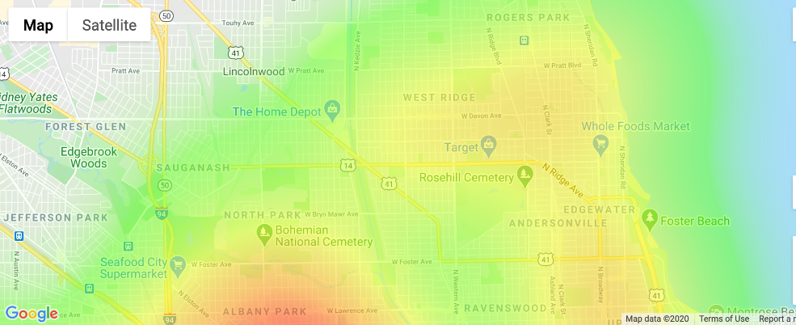
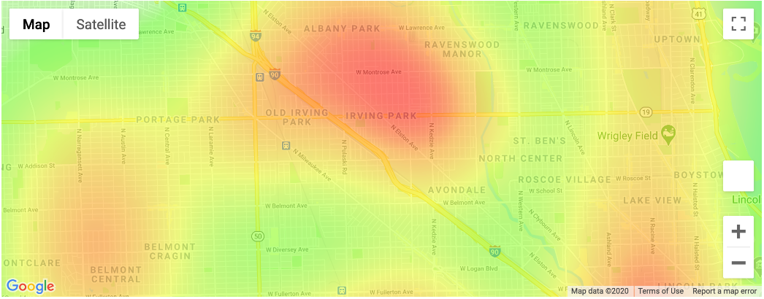
Heatmap Chicago Crime

Slide 16
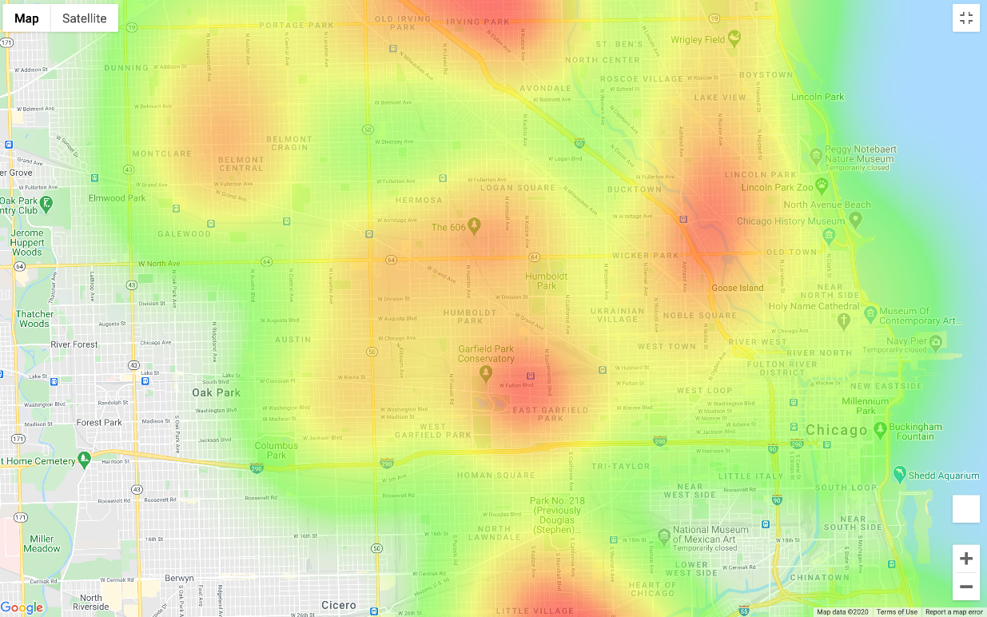

Slide 17
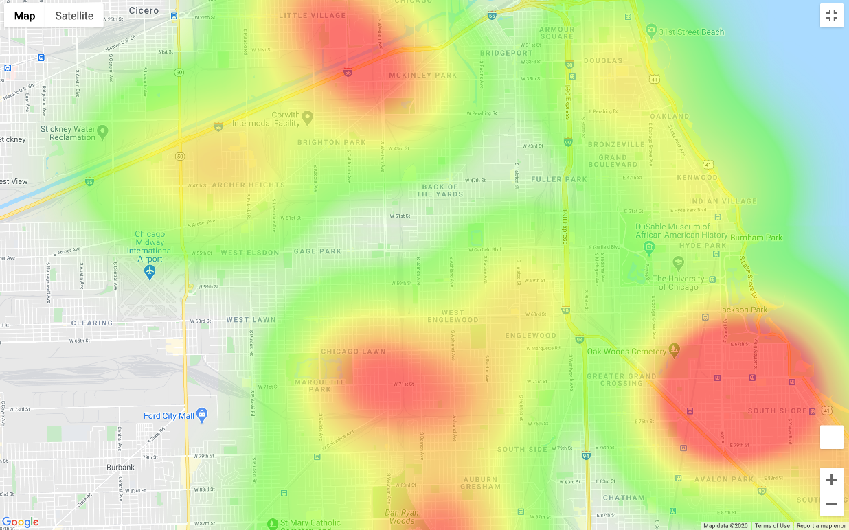

Slide 18
